Slide 1
Programming 1 - WEEK 6
Sets
Dictionaries

Slide 2


Slide 3

Recap
Arithmetic
Booleans
Conditionals
None
Strings
Loops
Tuples
Lists

Slide 4

Permanent Evaluation
Be quiet - no talking
Don't cheat, look at your own screen
ONLY allowed to be on ANS
No GenAI – No VSCode – No ppt – No notes – ...
Browser full screen, display light 100%
Scrap paper: strict rules (ask lecturer before test starts)
Duration: 10 minutes
Guess correction: - 1 / (# options – 1) (*)
Close your laptop when finished
(*) only for multiple choice questions

Slide 5
Permanent Evaluation
RESULTS?
Via ANS later today
Less then 14/20 → We expect you in the Skills session
Discussion of question & answers → Skills session

Slide 6
Programming 1 - WEEK 6
Sets
Dictionaries

Slide 7
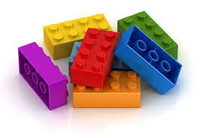

Collections
Basic building blocks = int, float, bool, string
Glueing them together = collection
Tuples
Lists
Sets
Dictionaries
…

Slide 8


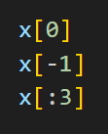







Tuples & Lists

Slide 9
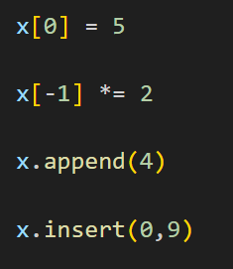
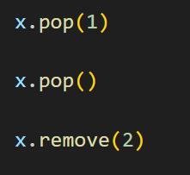
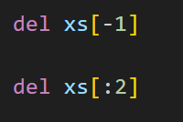
Lists

Slide 10

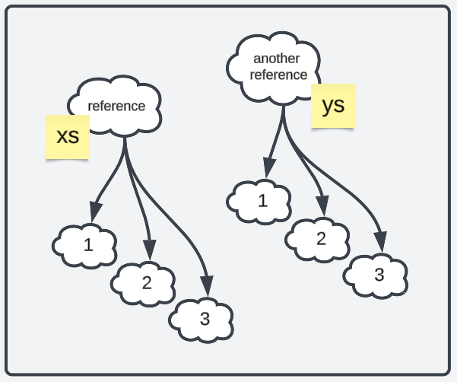
Lists
Efficiency
Add / remove element
at end of list FAST
at the beginning of list SLOW
Membership testing (x in list) SLOW

Slide 11
Collections
Basic building blocks = int, float, bool, string
Glueing them together = collection
Tuples
Lists
Sets
Dictionaries
…

Slide 12


Sets
Very similar syntax:
{ }
name of the set
a, b, c, d … are its content
- int
- float
- boolean
- string
- Tuple/List/Set (or other collections)
or any combination of the
above

Slide 13


Sets
Add / remove / membership
are very fast !
Unordered
No index
No duplicates allowed
Set or list?
Set for efficiency
List for order and duplicates

Slide 14
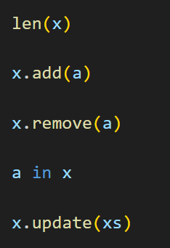
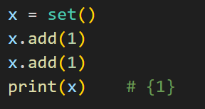
Sets - Functionality
Not append or insert!
Example:
Or discard() to avoid error
Fast!
To add multiple elements

Slide 15






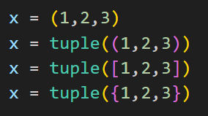
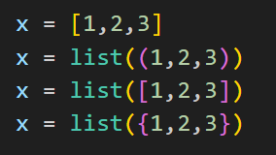
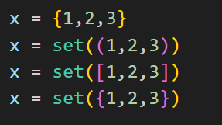
Collections - Creation

Slide 16

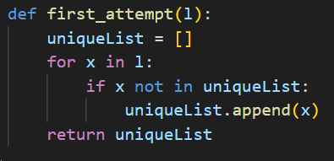
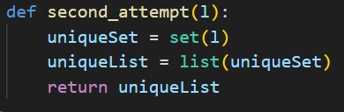
Collections - Example
Return a copy with all duplicates removed…
BUT this solution contains 2 nested loops through a list → not efficiënt
More efficiënt! Note: The order of the elements in the unique list is random

Slide 17

Questions?

Slide 18
Collections
Basic building blocks = int, float, bool, string
Glueing them together = collection
Tuples
Lists
Sets
Dictionaries
…

Slide 19

Dictionaries
New syntax!
{ : }
Keys and values can be any* type (boolean, string, int, another dictionary…)
* Later more on the limitations
name of the
dictionary
The key-value pairs are its content

Slide 20

Dictionaries
New syntax!
{ : }
Example:
Key | Value
"a" | 1
"b" | 2
"c" | 1

Slide 21
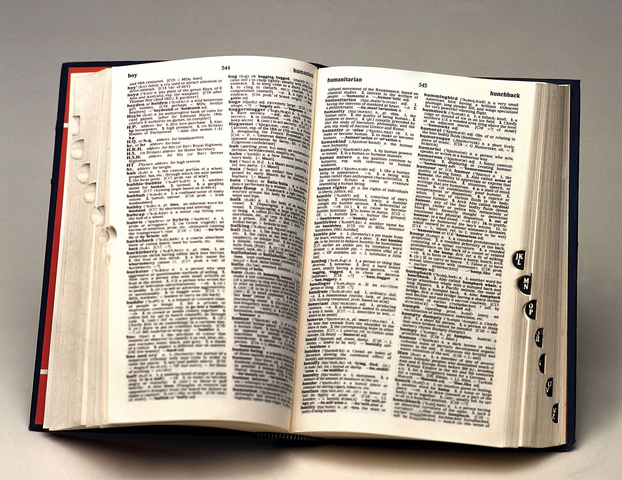
Dictionaries - Functionality
Lookup
Insert
Modify
Delete
Membership
Enumerating

Slide 22
Dictionaries - Functionality
Lookup
Insert
Modify
Delete
Membership
Enumerating

Slide 23


Dictionaries - Lookup
Key | Value
"Cat" | "Kat"
"Dog" | "Hond"
"Fish" | "Vis"
"Rabbit" | "Konijn"
The key is used as if it was an index
Alternative:

Slide 24




Dictionaries - Lookup
Key | Value
"Cat" | "Kat"
"Dog" | "Hond"
"Fish" | "Vis"
"Rabbit" | "Konijn"
Add default value:

Slide 25

Dictionaries - Insert
Key | Value
"Cat" | "Kat"
"Dog" | "Hond"
"Fish" | "Vis"
"Rabbit" | "Konijn"
Key | Value
"Cat" | "Kat"
"Dog" | "Hond"
"Fish" | "Vis"
"Rabbit" | "Konijn"
"Mouse" | "Mus"
"Monkey" | "Aap"

Slide 26

Dictionaries - Modify
Key | Value
"Cat" | "Kat"
"Dog" | "Hond"
"Fish" | "Vis"
"Rabbit" | "Konijn"
"Mouse" | "Mus"
"Monkey" | "Aap"
Key | Value
"Cat" | "Kat"
"Dog" | "Hond"
"Fish" | "Vis"
"Rabbit" | "Konijn"
"Mouse" | "Muis"
"Monkey" | "Aap"

Slide 27

Dictionaries - Delete
Key | Value
"Cat" | "Kat"
"Dog" | "Hond"
"Fish" | "Vis"
"Rabbit" | "Konijn"
Key | Value
"Cat" | "Kat"
"Dog" | "Hond"
"Fish" | "Vis"
"Rabbit" | "Konijn"
"Mouse" | "Muis"
"Monkey" | "Aap"

Slide 28

Dictionaries - Delete
Key | Value
"Cat" | "Kat"
"Dog" | "Hond"
"Fish" | "Vis"
"Rabbit" | "Konijn"

Slide 29
Dictionaries - Functionality
Lookup
Insert
Modify
Delete
Membership
Enumerating

Slide 30


Dictionaries - Membership
Key | Value
"Cat" | "Kat"
"Dog" | "Hond"
"Fish" | "Vis"
"Rabbit" | "Konijn"
Only works for keys This way you cannot look for values

Slide 31


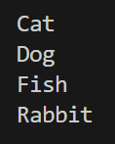
Dictionaries - Enumerating
Key | Value
"Cat" | "Kat"
"Dog" | "Hond"
"Fish" | "Vis"
"Rabbit" | "Konijn"

Slide 32

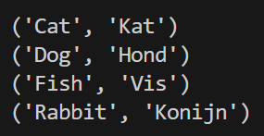
Dictionaries - Enumerating
Key | Value
"Cat" | "Kat"
"Dog" | "Hond"
"Fish" | "Vis"
"Rabbit" | "Konijn"

Slide 33


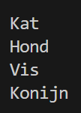

Dictionaries - Enumerating
Key | Value
"Cat" | "Kat"
"Dog" | "Hond"
"Fish" | "Vis"
"Rabbit" | "Konijn"

Slide 34
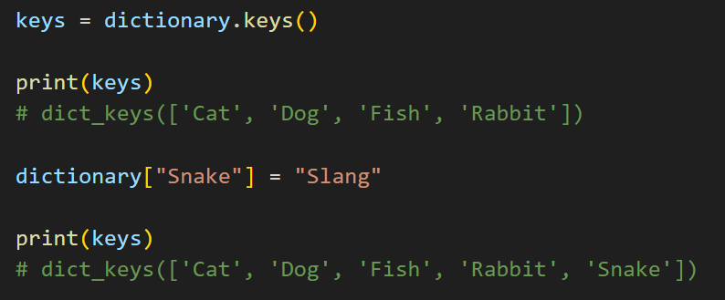

Dictionaries - Enumerating
dictionary.items()
dictionary.keys()
dictionary.values()
Not really a list
It looks very much like one
It is smarter!
NOT possible to use indexing though

Slide 35
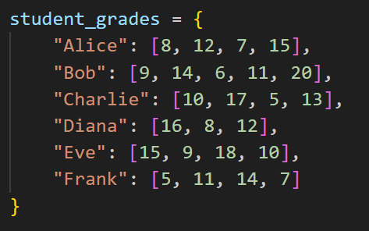

Dictionaries - DEMO
Given the dictionary on the right.
Write a function
get_result(student_grades,name)
that returns the overall result of a given student.
To define the overall result, the average of all their grades should be calculated.
Also write a function best_student(student_grades) that returns the name of the student that has the best overall result.

Slide 36
Questions?

Slide 37


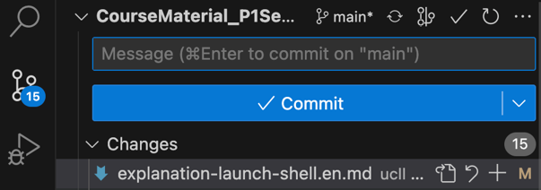
Git - Pulling changes
If you get an error telling you that you have to set a default merge strategy:
(then pull again)
If you get an error telling you that you have conflicting working changes, make sure to discard any changes you might have made to assignment or test files. (Changes to student.py files are ok since we don't modify those)

